Slide 1
CAPSTONE PROJECT
Online Bus Reservation System- BookMyBus
Make your ride easy

Slide 2
Table of Contents
Problem Statement and Solution
Introduction
Aim of the project
Objective of the project
System Requirements
Technologies Used
Project Modules & User Characteristics
Screenshots of the Project
Future Scope
Conclusion

Slide 3
PROBLEM STATEMENT
In the fast connected society, we need a quick way to commute to our destination, which is exactly why we need a user friendly application with a dynamic system to maintain the information systematically.
A Software application is required to be developed for automating the online reservation for buses.
A platform which provides an easy and efficient way to access and reserve seats in the bus, which is most comfortable means for long journeys.

Slide 4
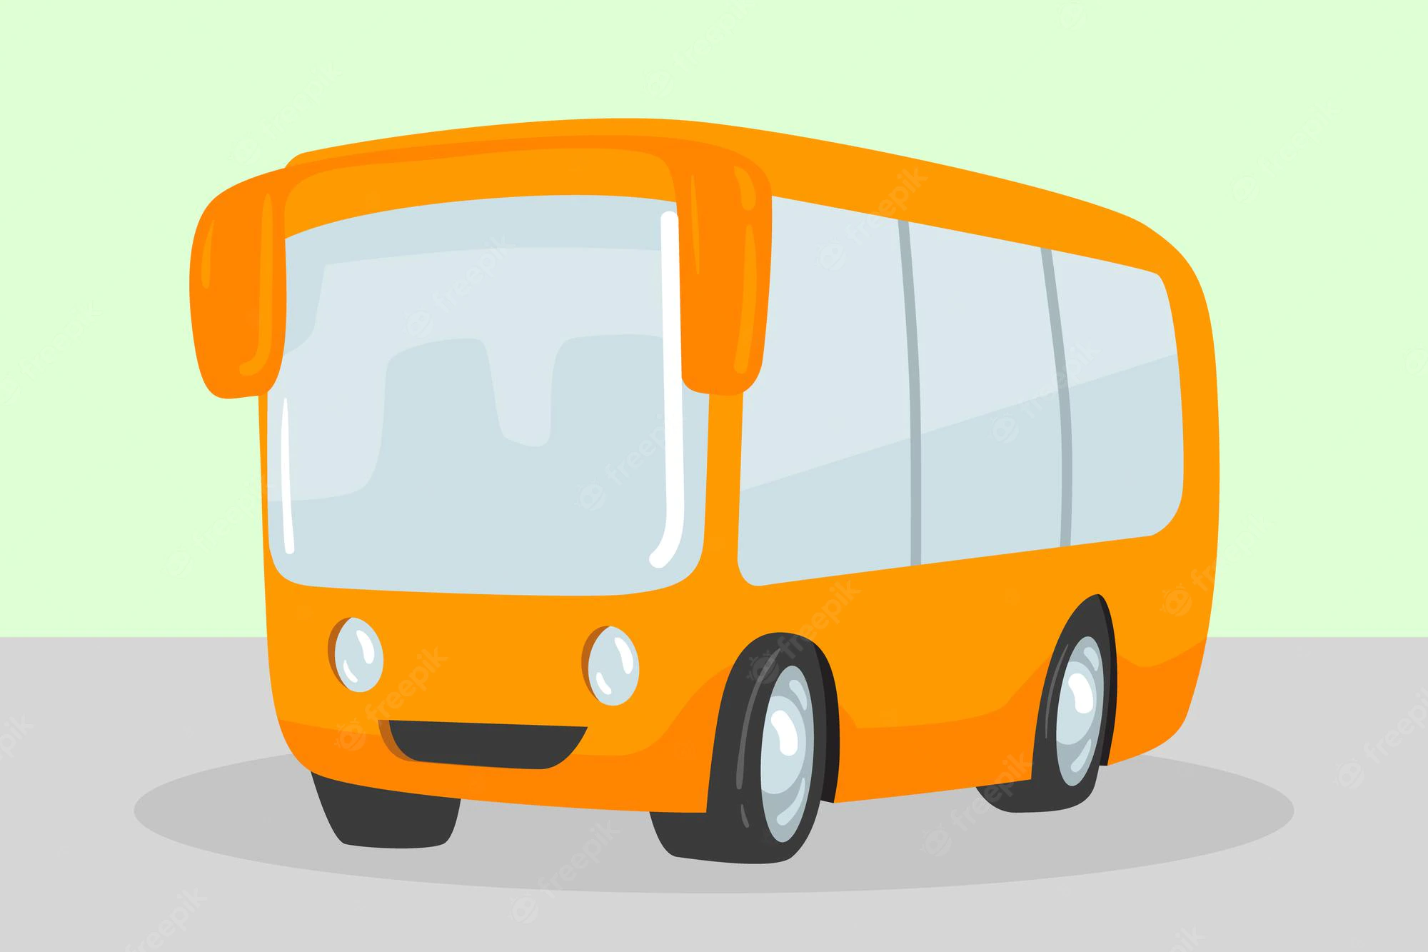
SOLUTION
The application is designed to provide functionalities like searching and booking tickets for the user and also enables the admin to store and update bus information, routes and other details.
The software application provides an easy navigation to book bus tickets with a dynamic user interface.
The information is saved, and the corresponding details are updated in the database.

Slide 5

INTRODUCTION
For people to travel from one place to another, a medium of transport is very essential. This makes transportation system a very important part of our social life. Out of the many options available, bus is the most inexpensive and convenient.
BookMyBus is a web application which provides a user-friendly interface to search and book bus tickets.
BookMyBus helps to maintain, manage and update all the bus related information, and allows the passengers to navigate through the application easily.

Slide 6
02
01
To allow customers to book tickets anywhere & anytime
To automate the booking system & maintaining all booking records
Aim of the
project
03
04
Provide customers with user friendly experience.
Enable users to download ticket & get journey details

Slide 7

OBJECTIVES
Providing a web-based bus ticket reservation function where a user can book bus tickets online without the need to queue up at the counter to buy bus ticket.
Enabling customers to check the availability and types of busses online.
Allowing customers to cancel their reservation.
Admin user privileges in updating/adding buses and maintaining bookings and user records.

Slide 8
SYSTEM REQUIREMENTS
SOFTWARE | HARDWARE
JDK 1.8 & above VS Code editor MongoDB v14 Eclipse IDE Postman | RAM:2 GB or above Disk Space:1GB or above
 | _____

Slide 9
Technologies Used
Spring Boot v2.5
Angular v8.0
MongoDB v14
Bootstrap v5.0
Hibernate with JPA v3.0
JUnit 5
Swagger

Slide 10
Registration/login
Update Profile
Search & Book bus
Booking Cancellation
Payment &
Print Ticket
Feedback
PROJECT MODULES

Slide 11
USER CHARACTERISTICS
Admin
Authorized Users
Login
Manage Buses
Manage Users
Manage Bookings
Manage Feedbacks
Register & Login
View & Edit profile
Booking
Cancel Booking
View Trip History
Payment
Download ticket
Give Feedback
Guest Users
Search Bus
Booking
Cancel booking
Payment
Download ticket
Give feedback

Slide 12
Project Screenshots

Slide 13
First
section
01
USER MODULE SCREENSHOTS

Slide 14
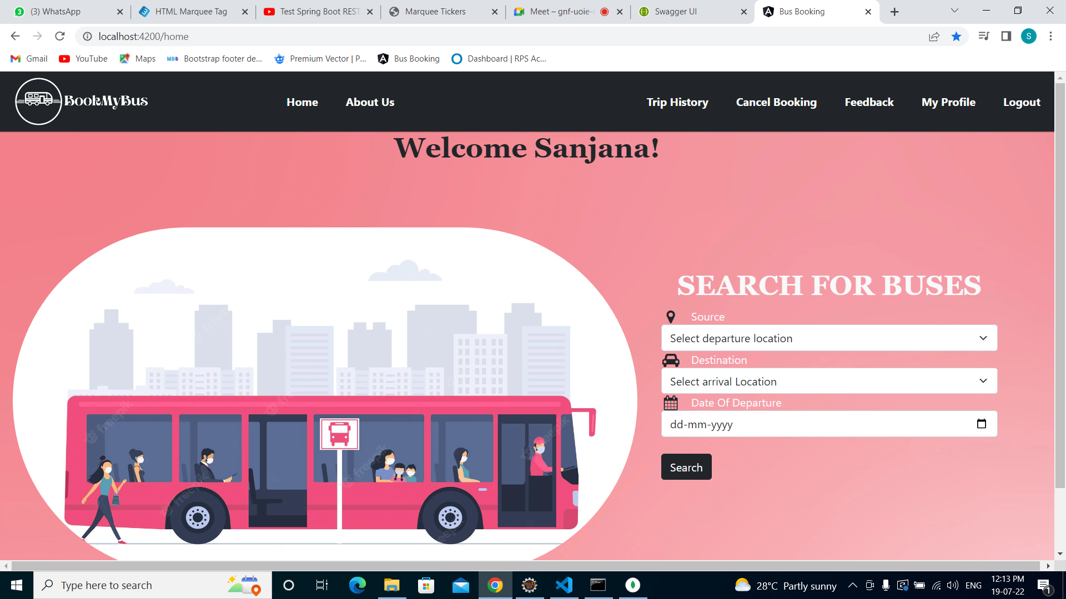
HOME PAGE

Slide 15
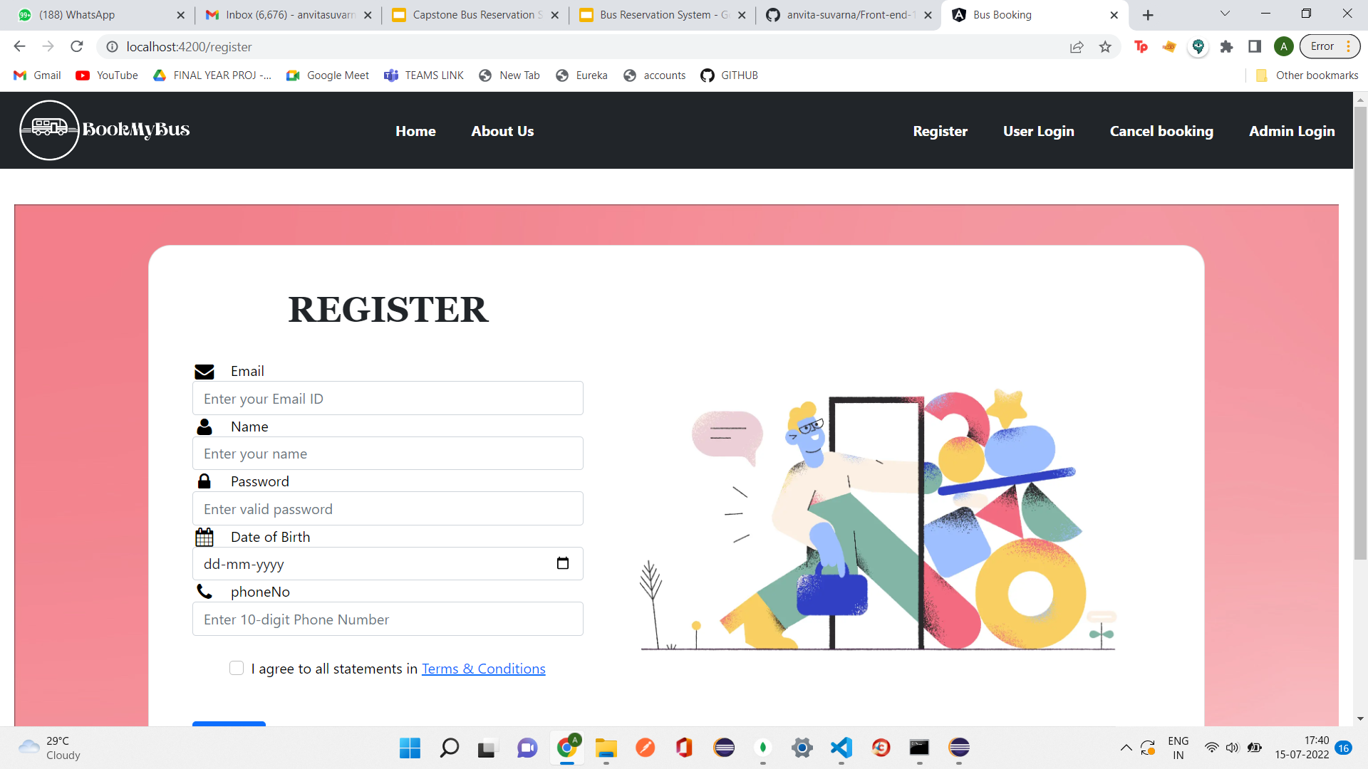
SIGN UP PAGE

Slide 16
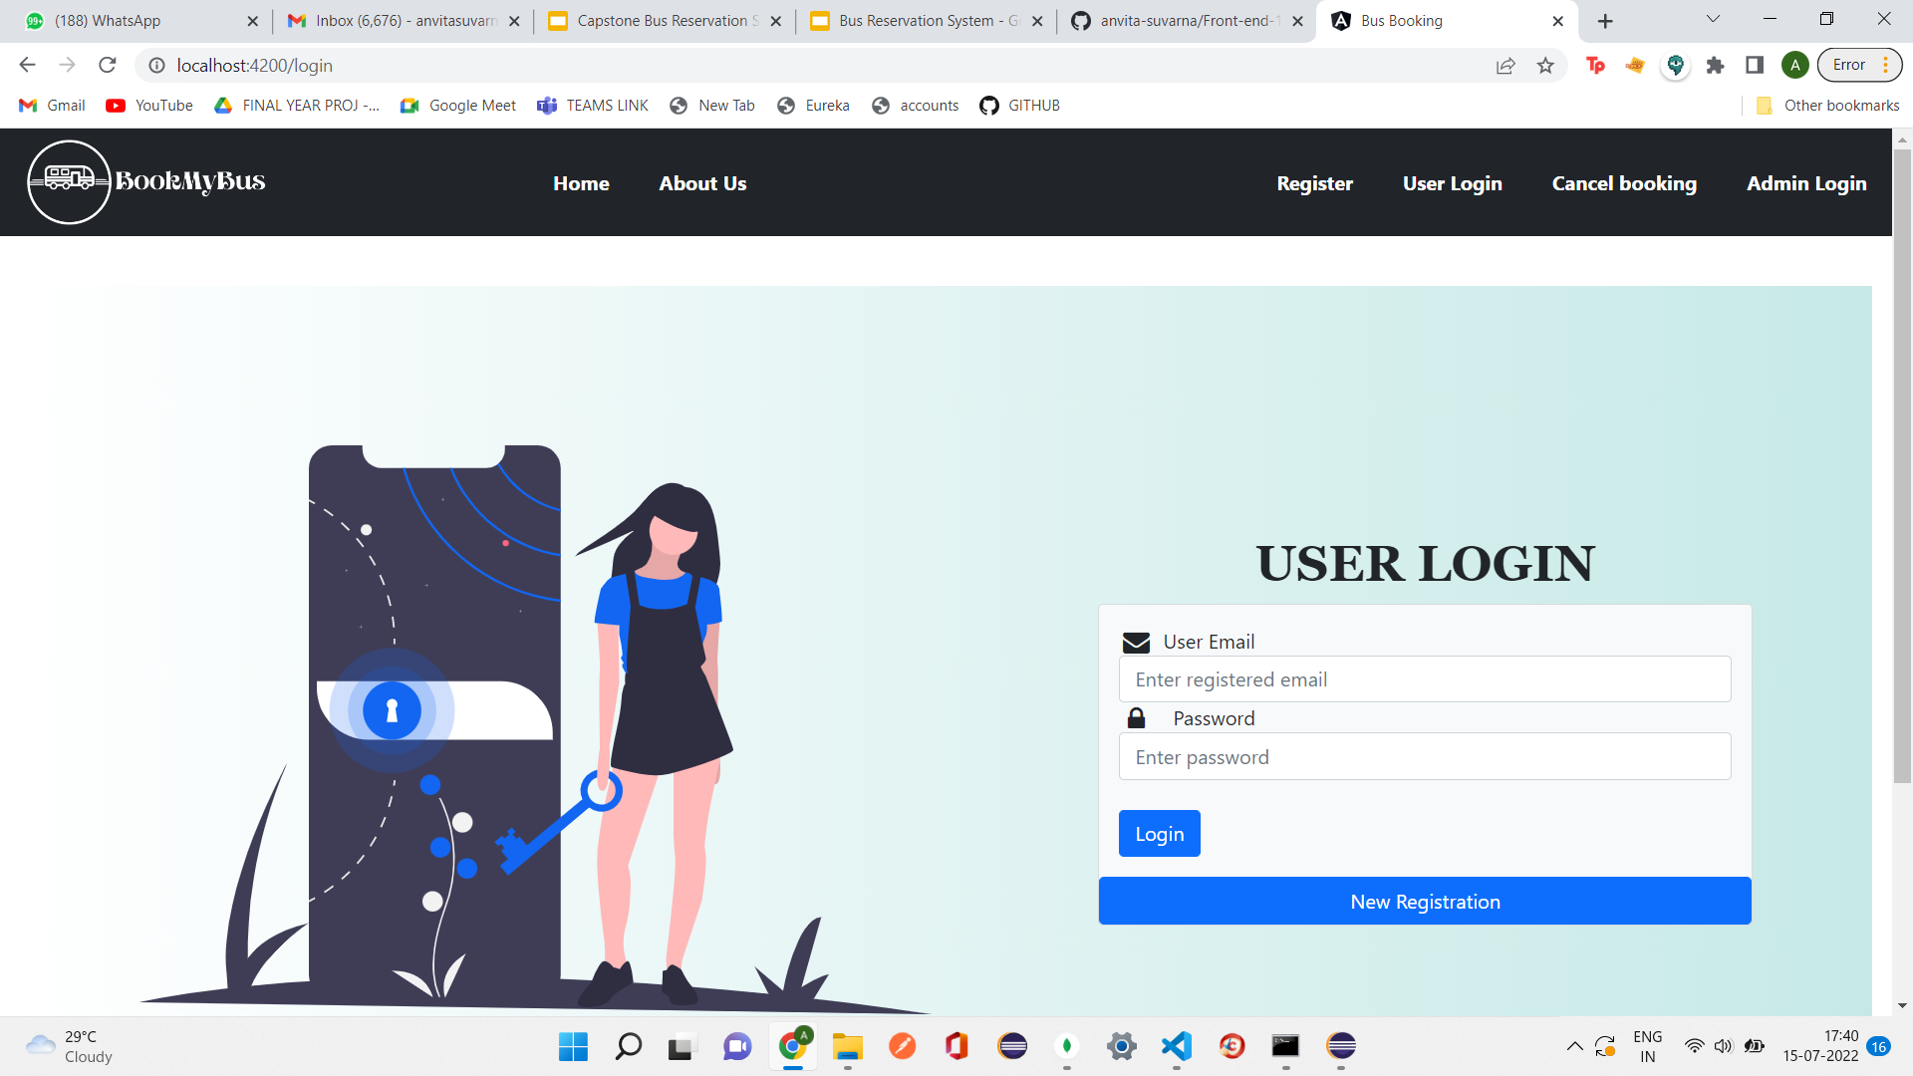
LOGIN PAGE

Slide 17
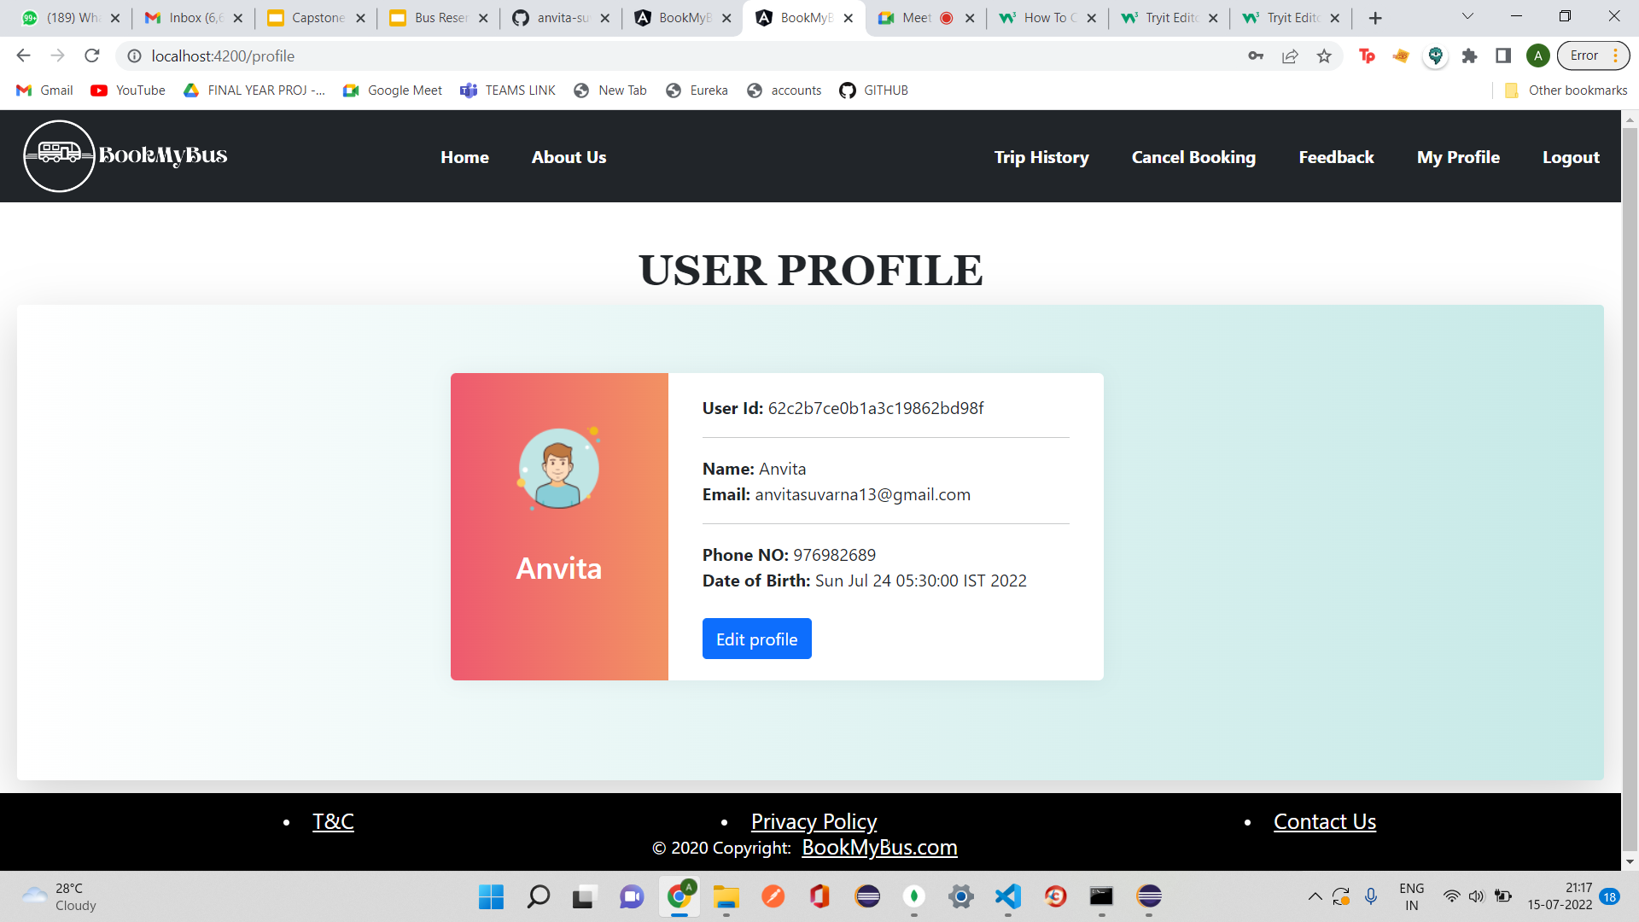
MY PROFILE PAGE

Slide 18
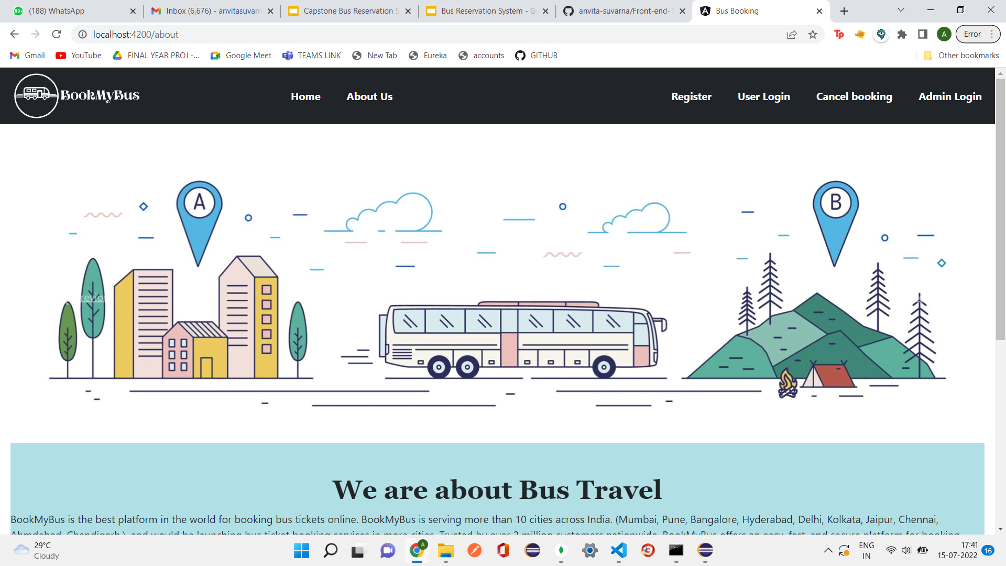
ABOUT US PAGE

Slide 19
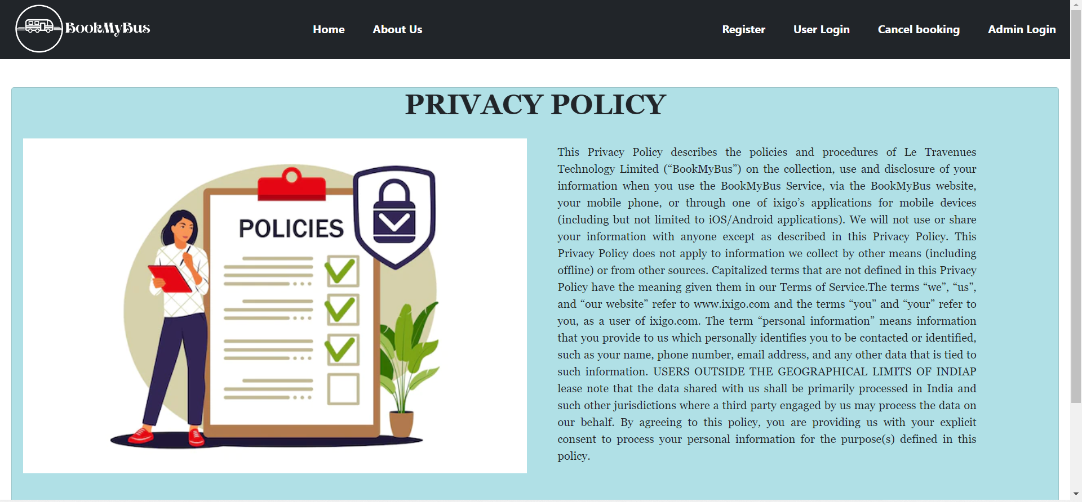
PRIVACY POLICY PAGE

Slide 20
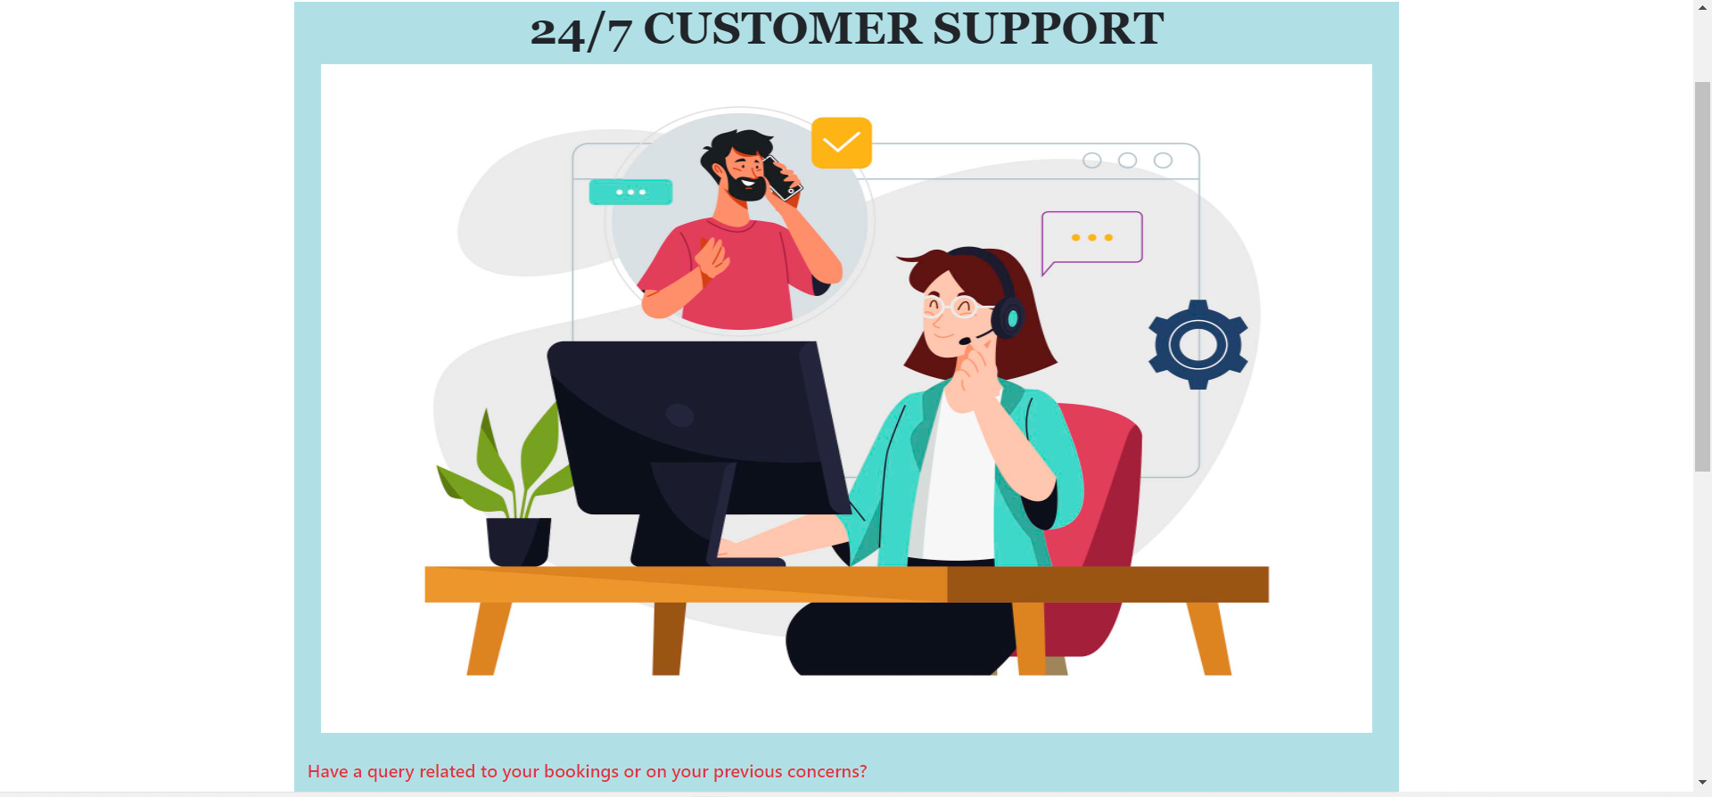
CONTACT US PAGE

Slide 21
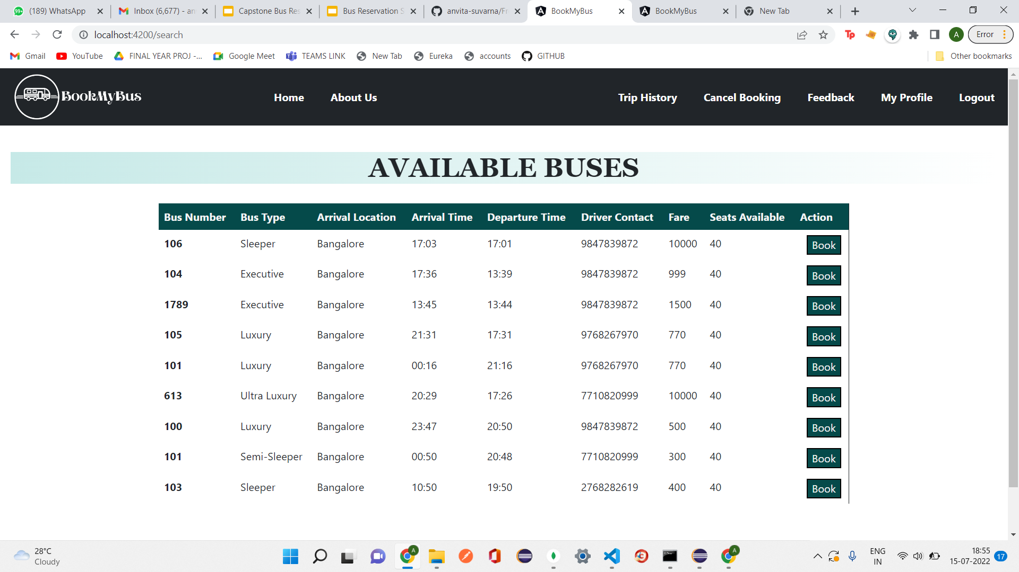
SEARCH BUSES PAGE

Slide 22
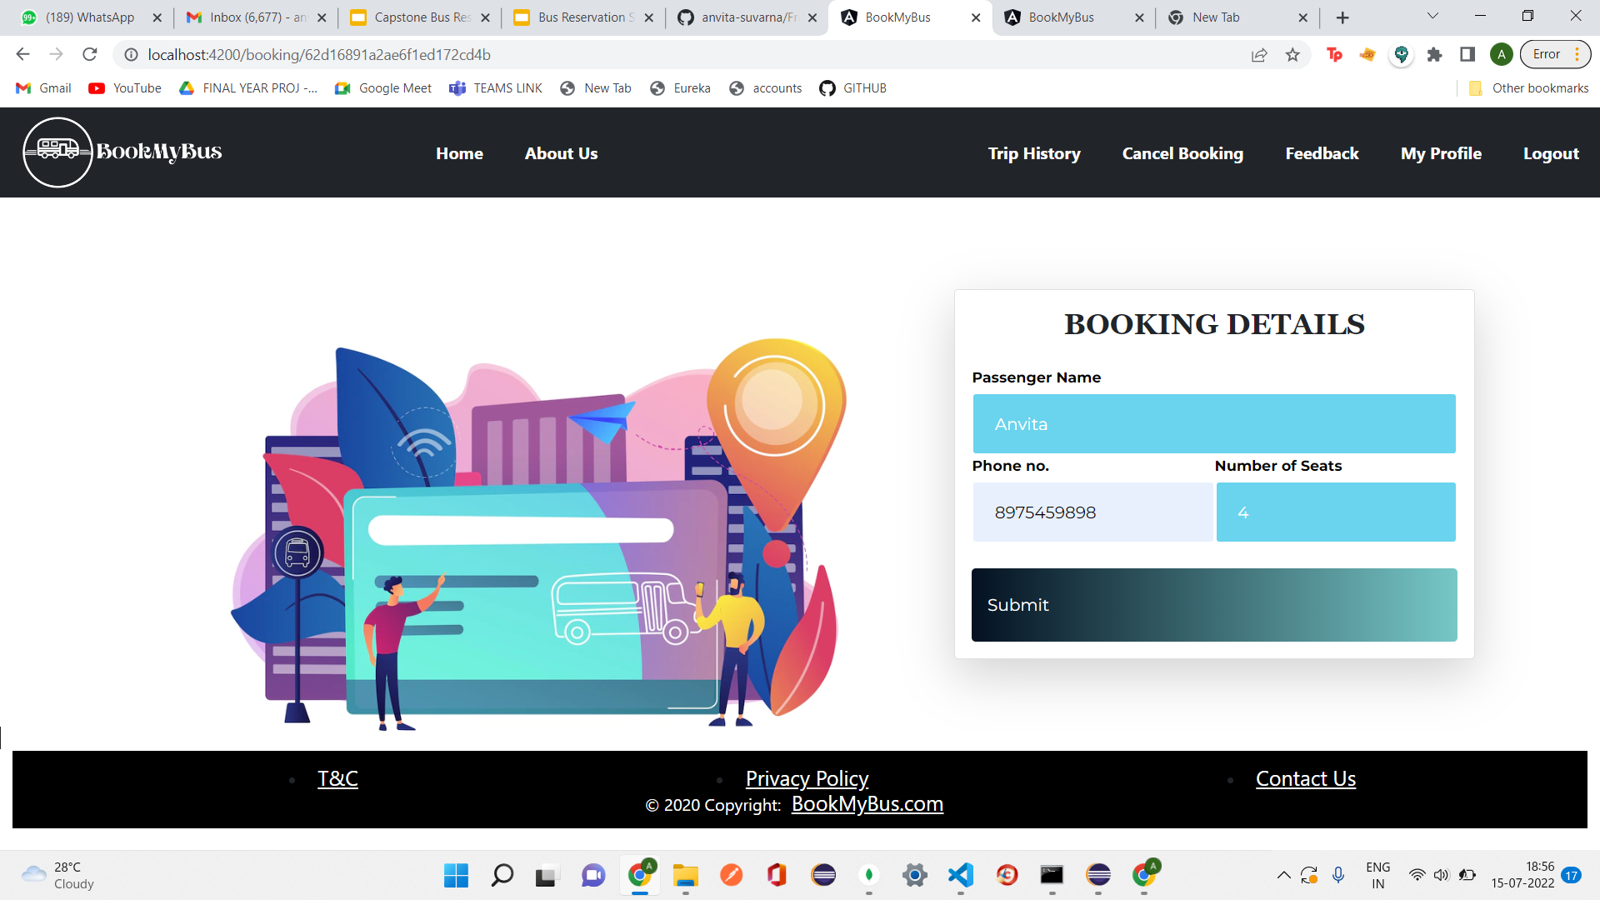
PASSENGER DETAILS PAGE

Slide 23
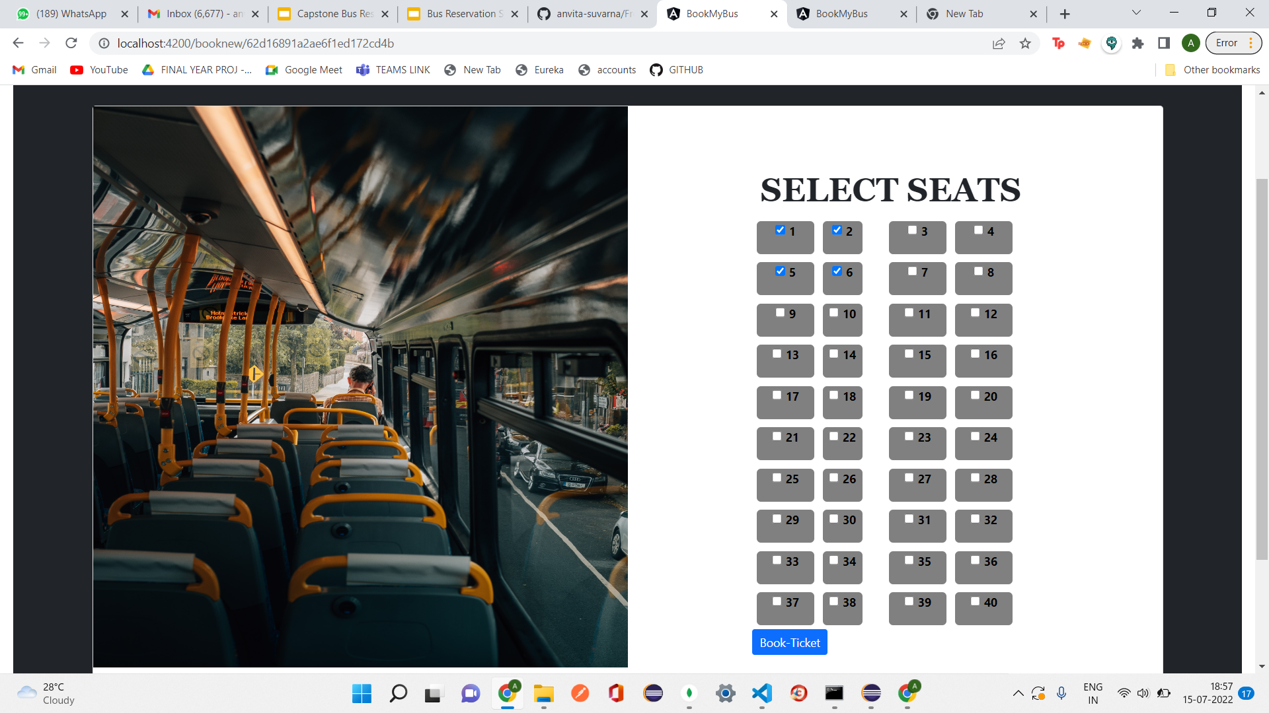
SELECT SEAT PAGE

Slide 24
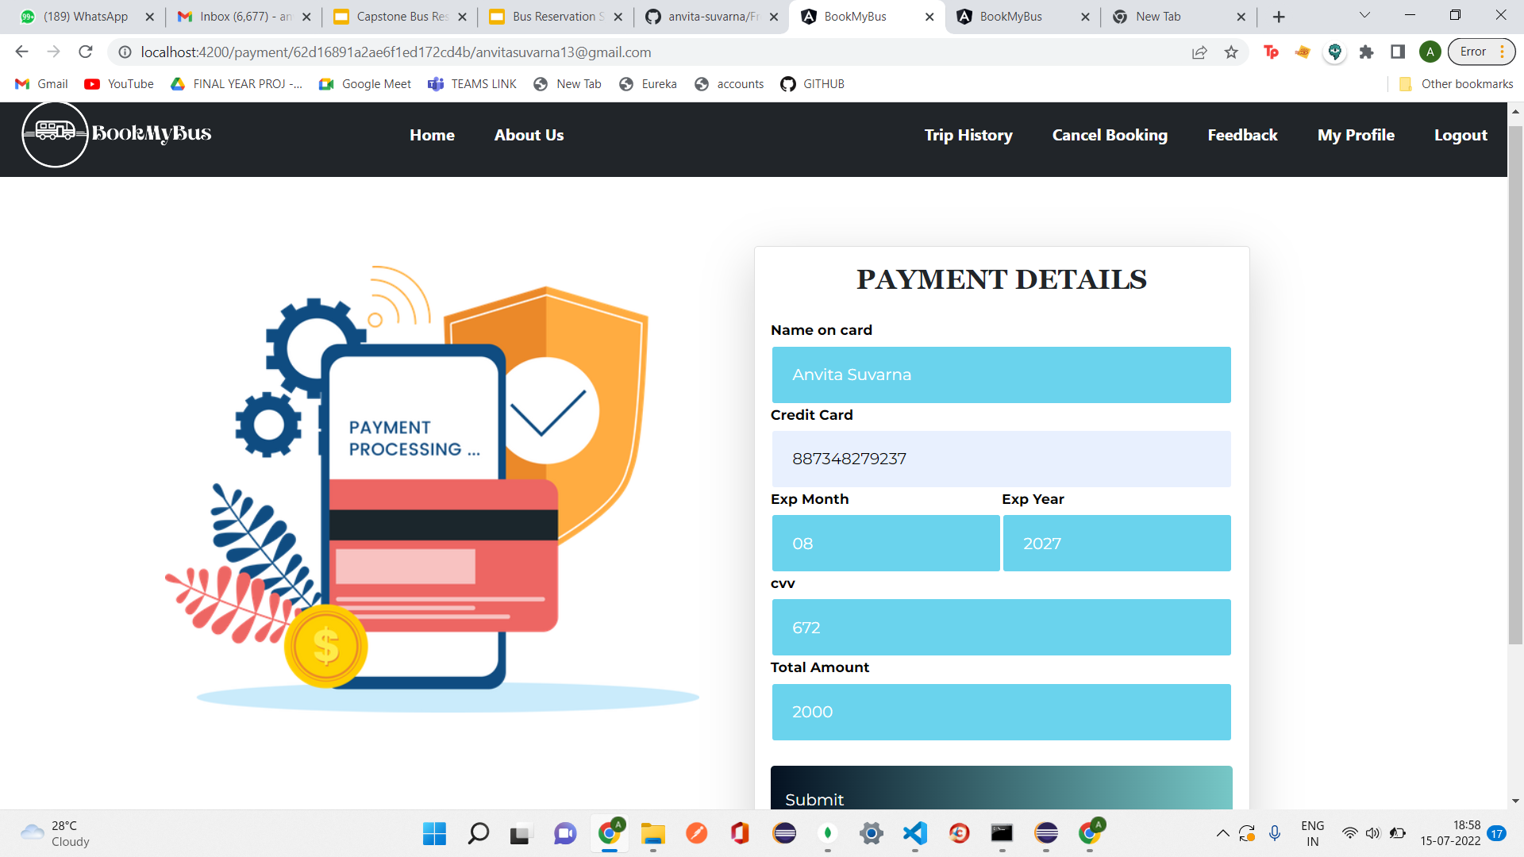
PAYMENT PAGE

Slide 25
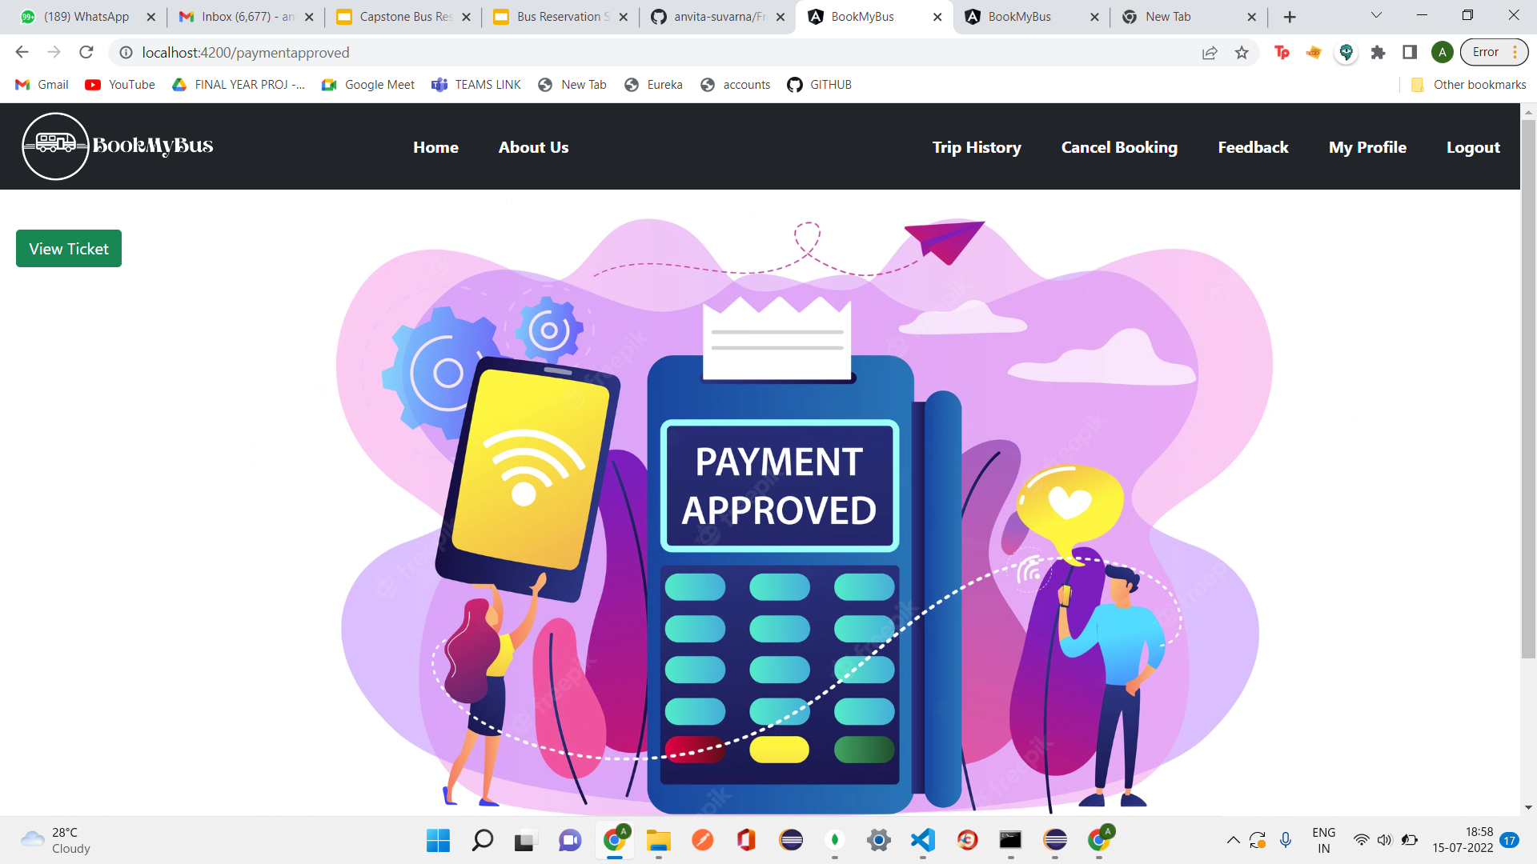
PAYMENT APPROVED PAGE

Slide 26
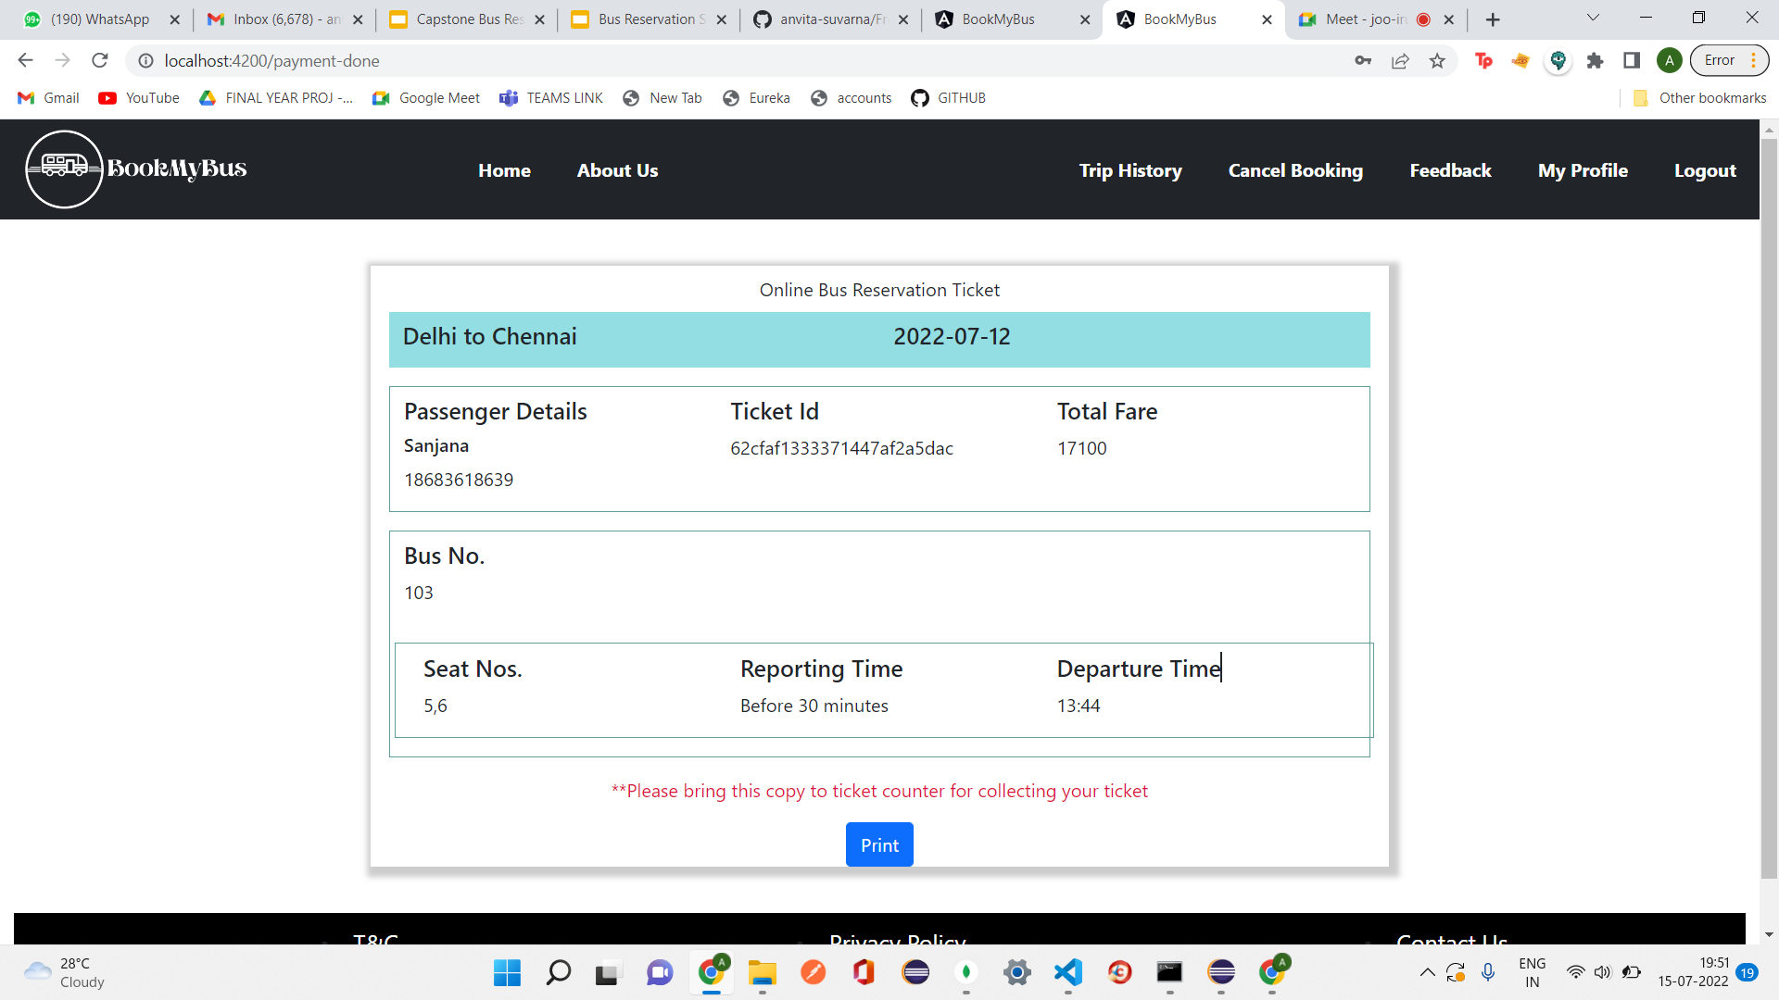
TICKET PAGE

Slide 27
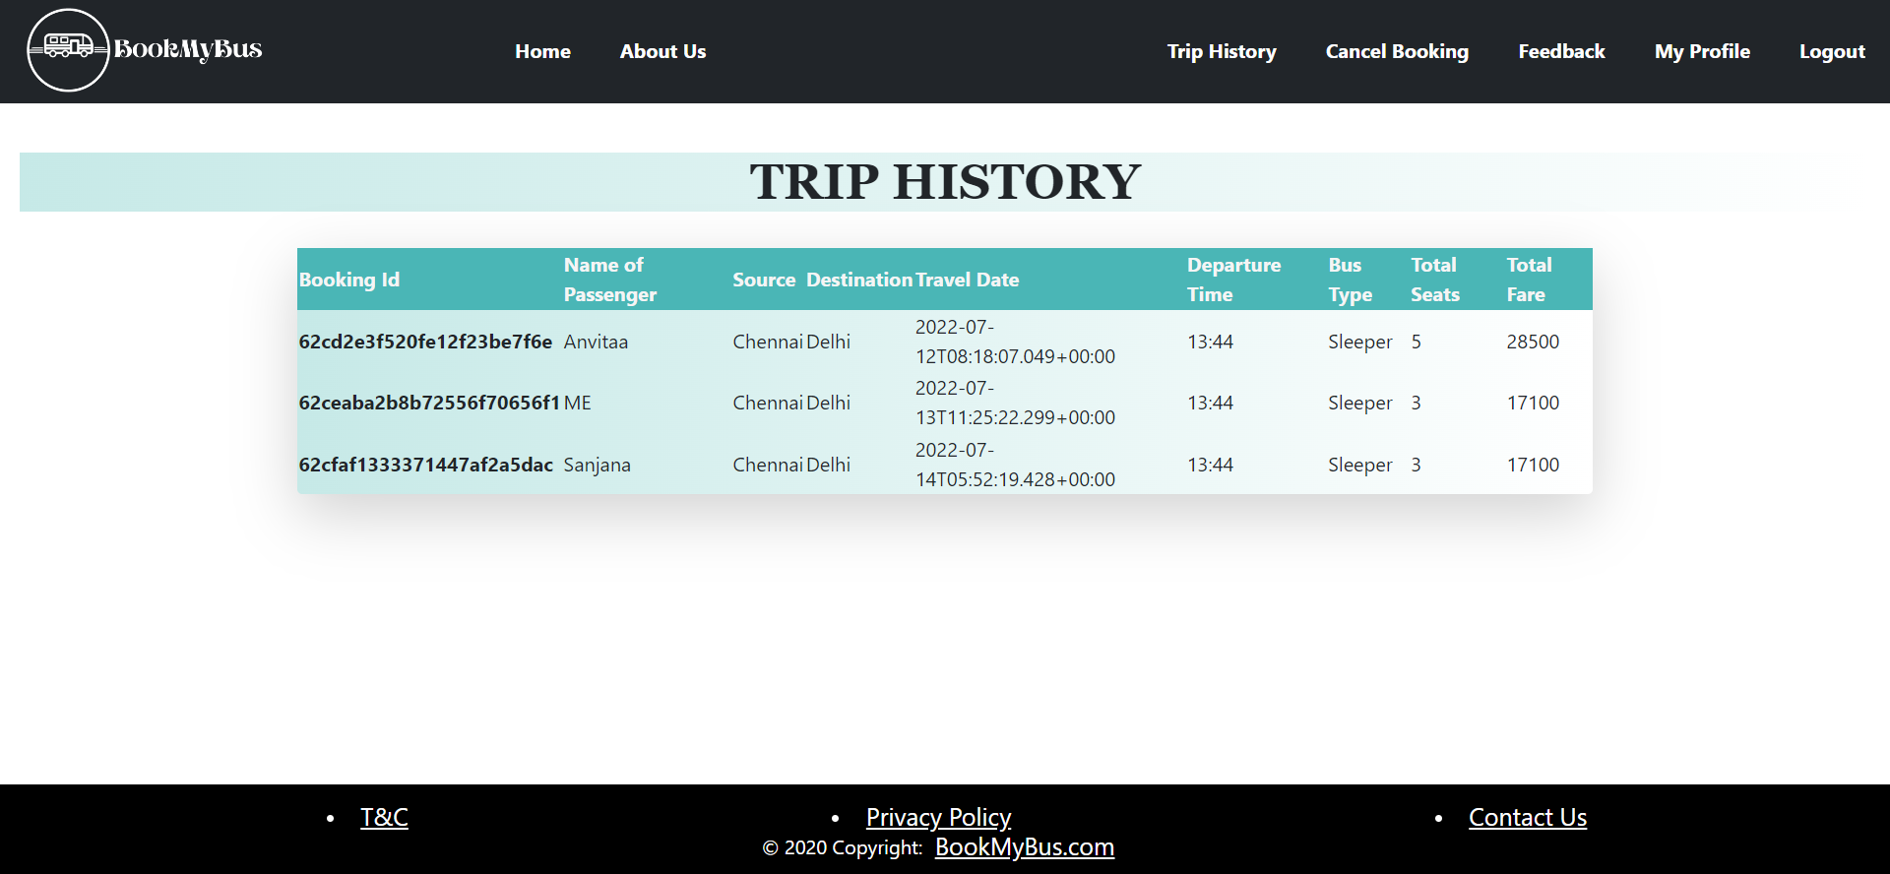
TRIP HISTORY PAGE

Slide 28
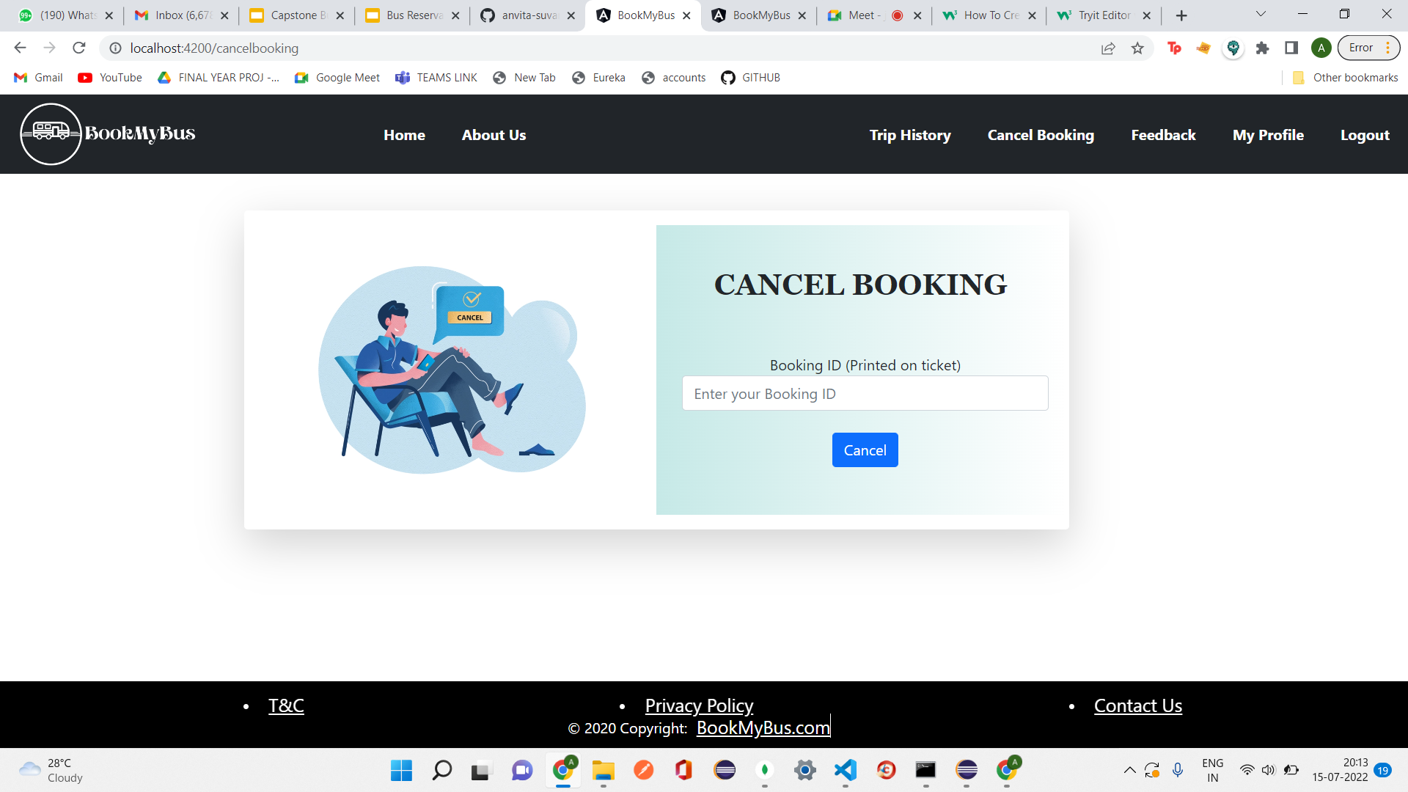
CANCEL BOOKING PAGE

Slide 29
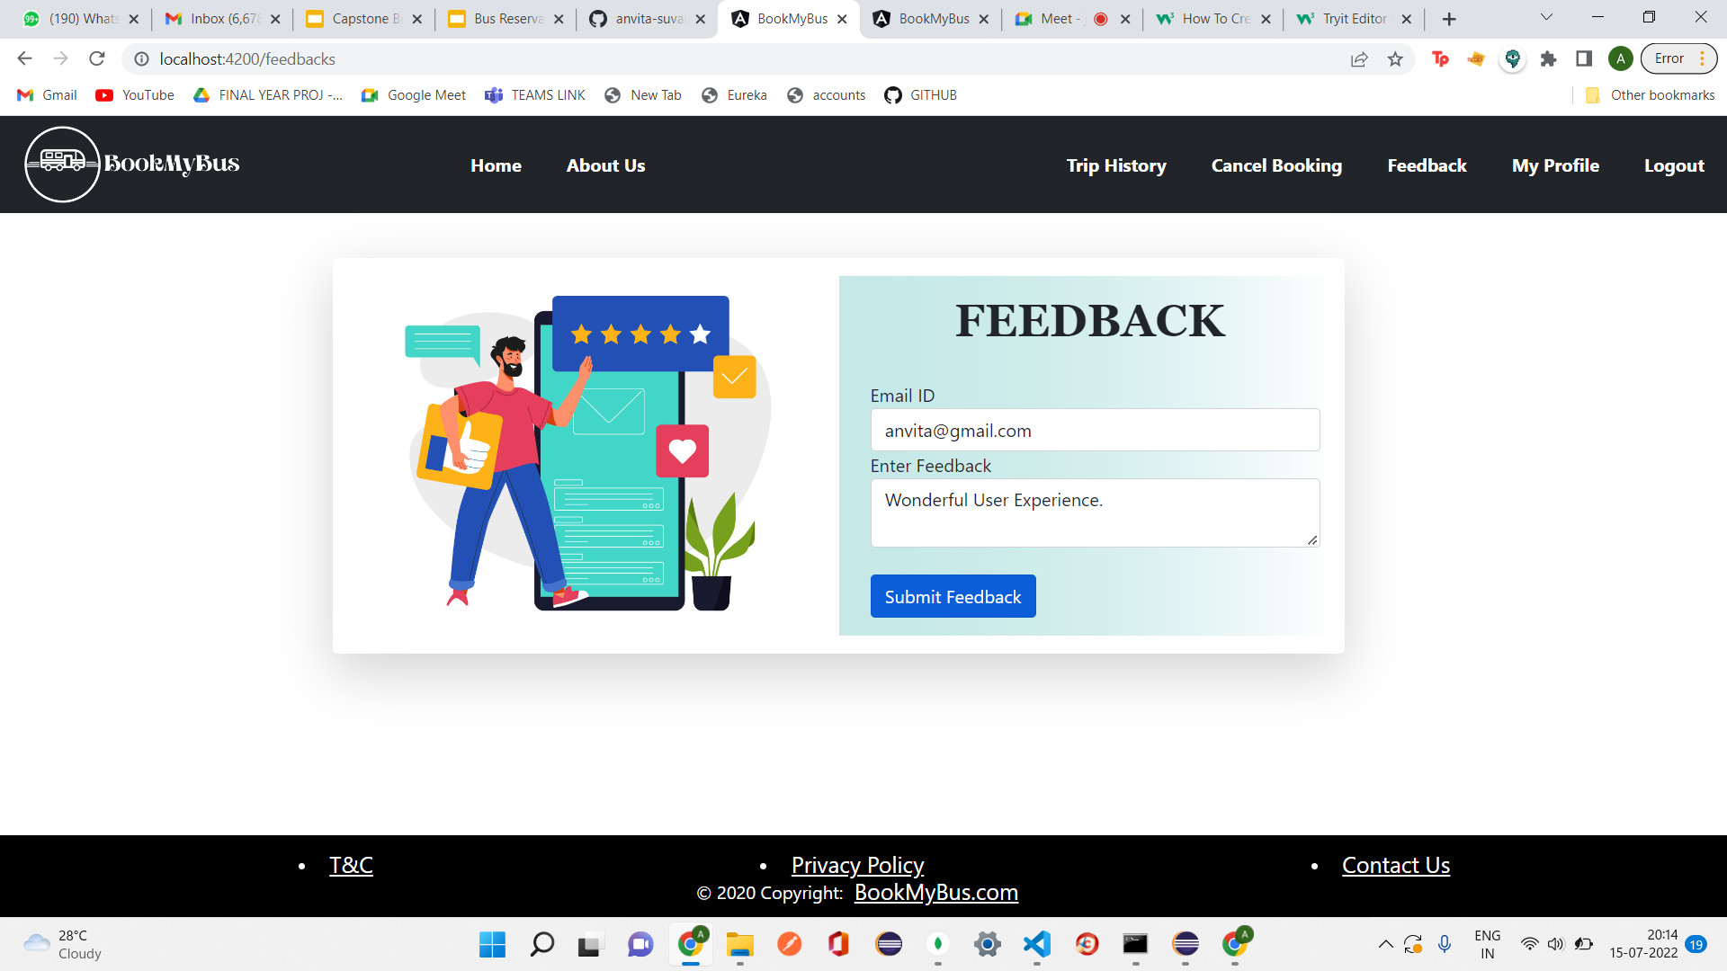
FEEDBACK PAGE

Slide 30
Second
section
02
ADMIN MODULE SCREENSHOTS

Slide 31
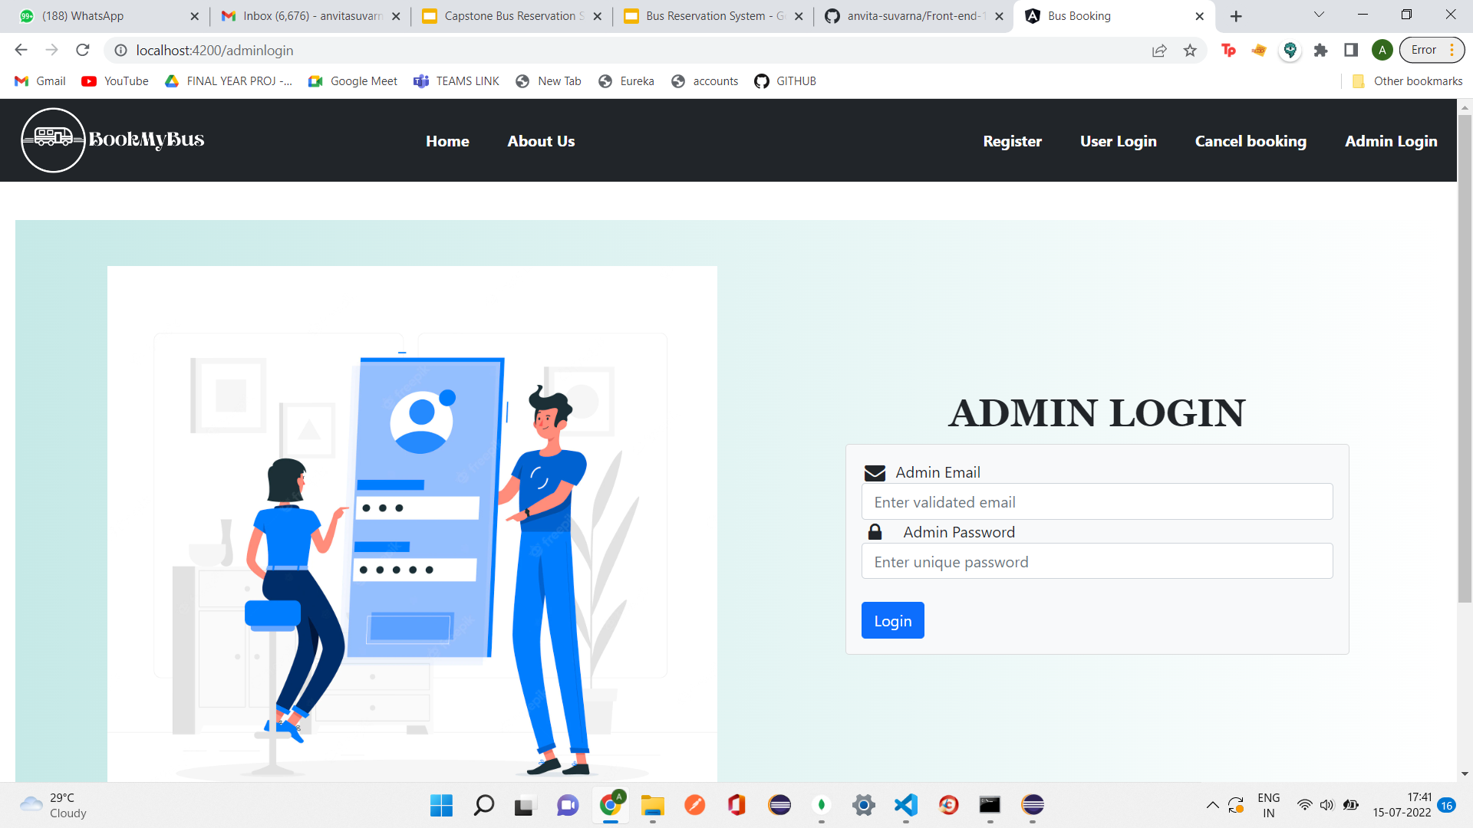
ADMIN LOGIN PAGE

Slide 32
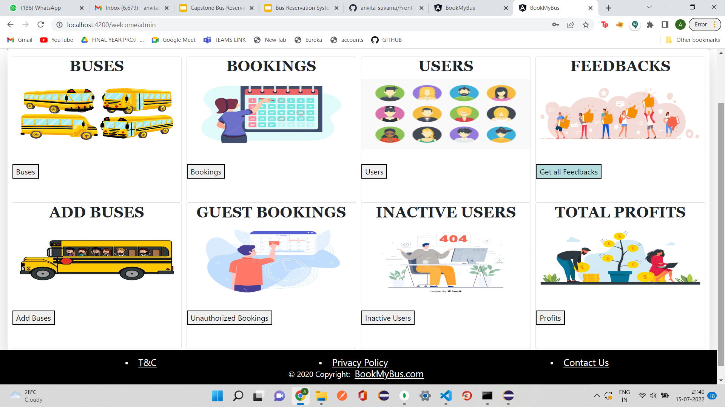
ADMIN DASHBOARD PAGE

Slide 33
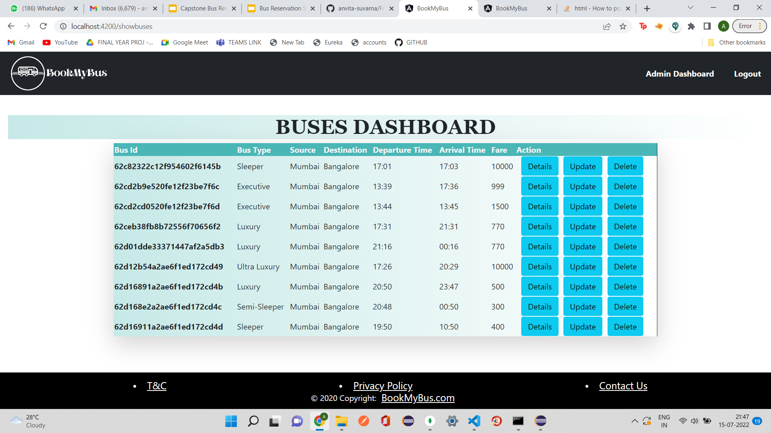
BUSES DASHBOARD PAGE

Slide 34
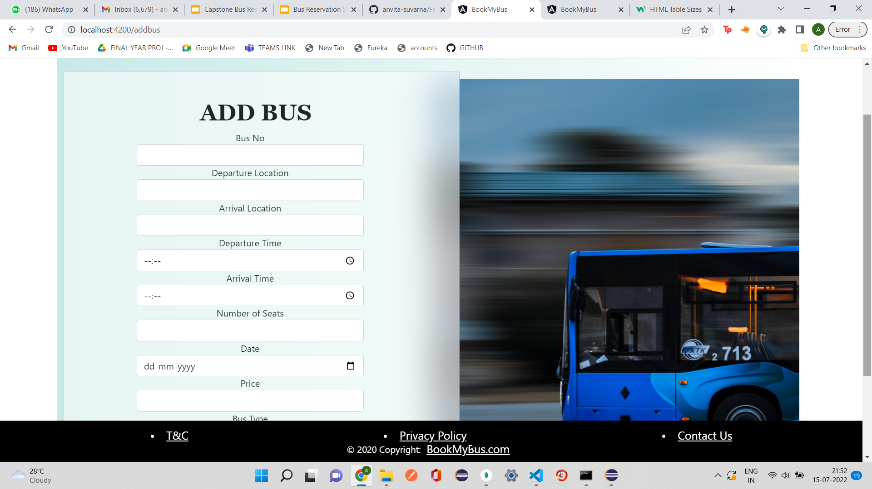
ADD BUS PAGE

Slide 35
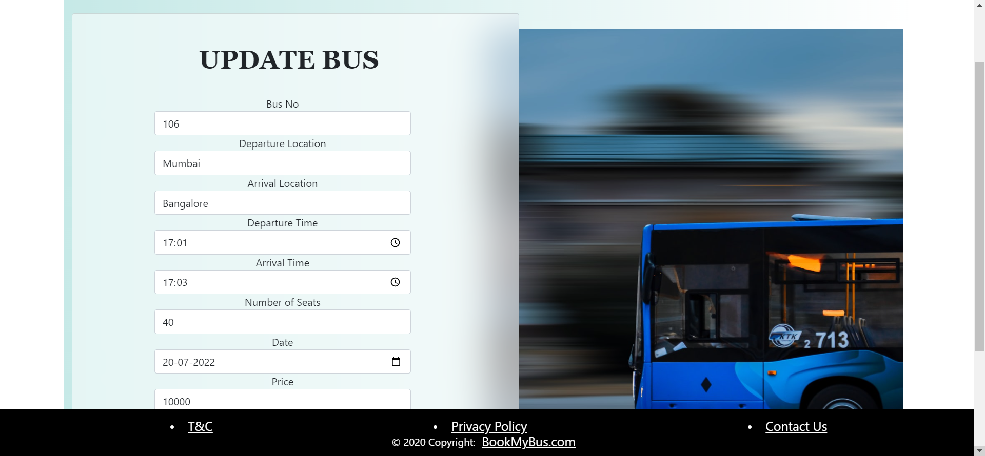
UPDATE BUS PAGE

Slide 36
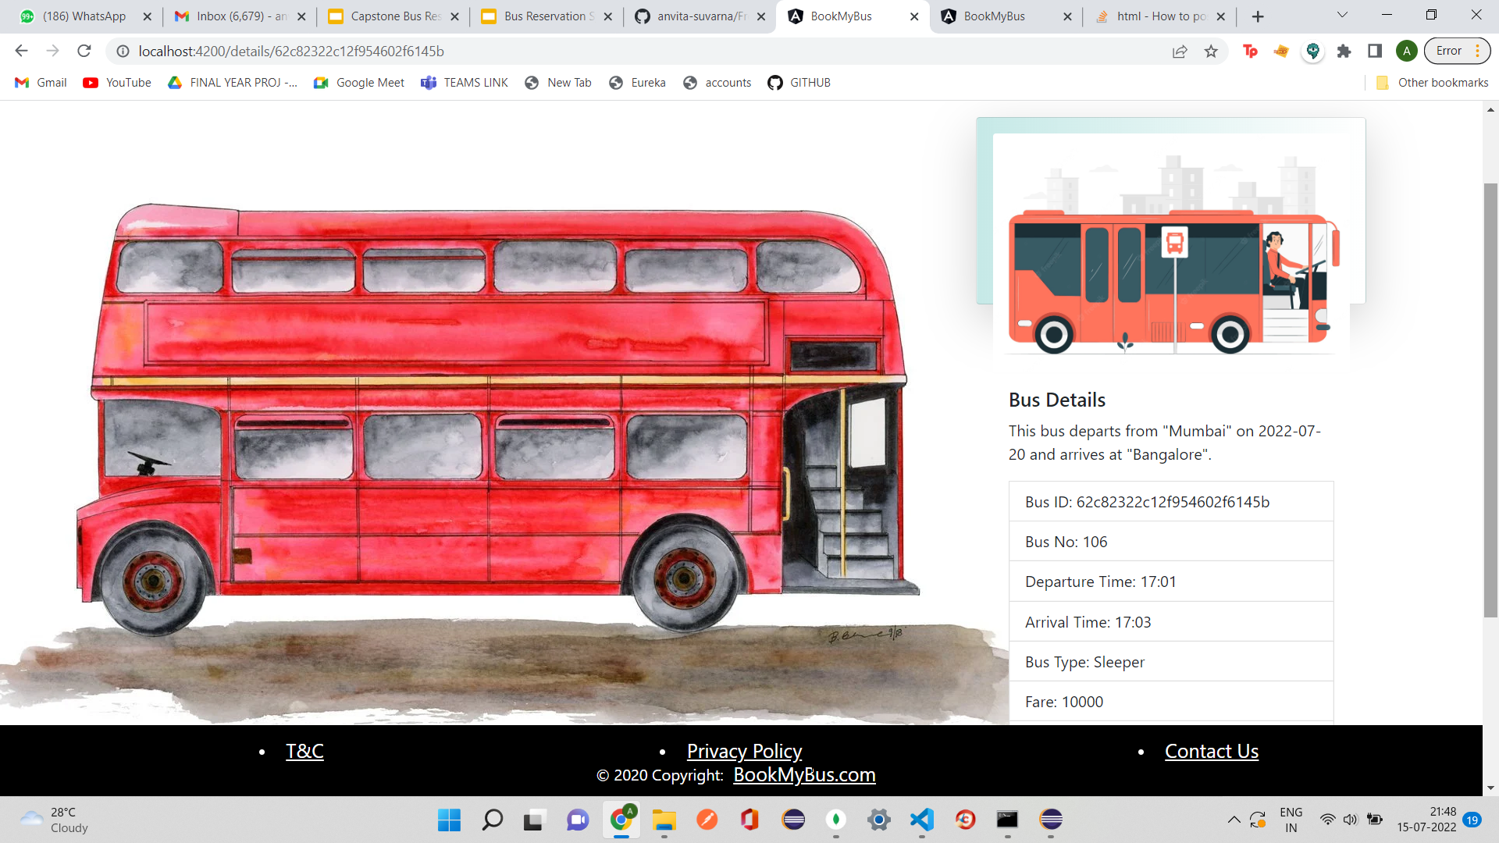
VIEW BUS DETAILS PAGE

Slide 37
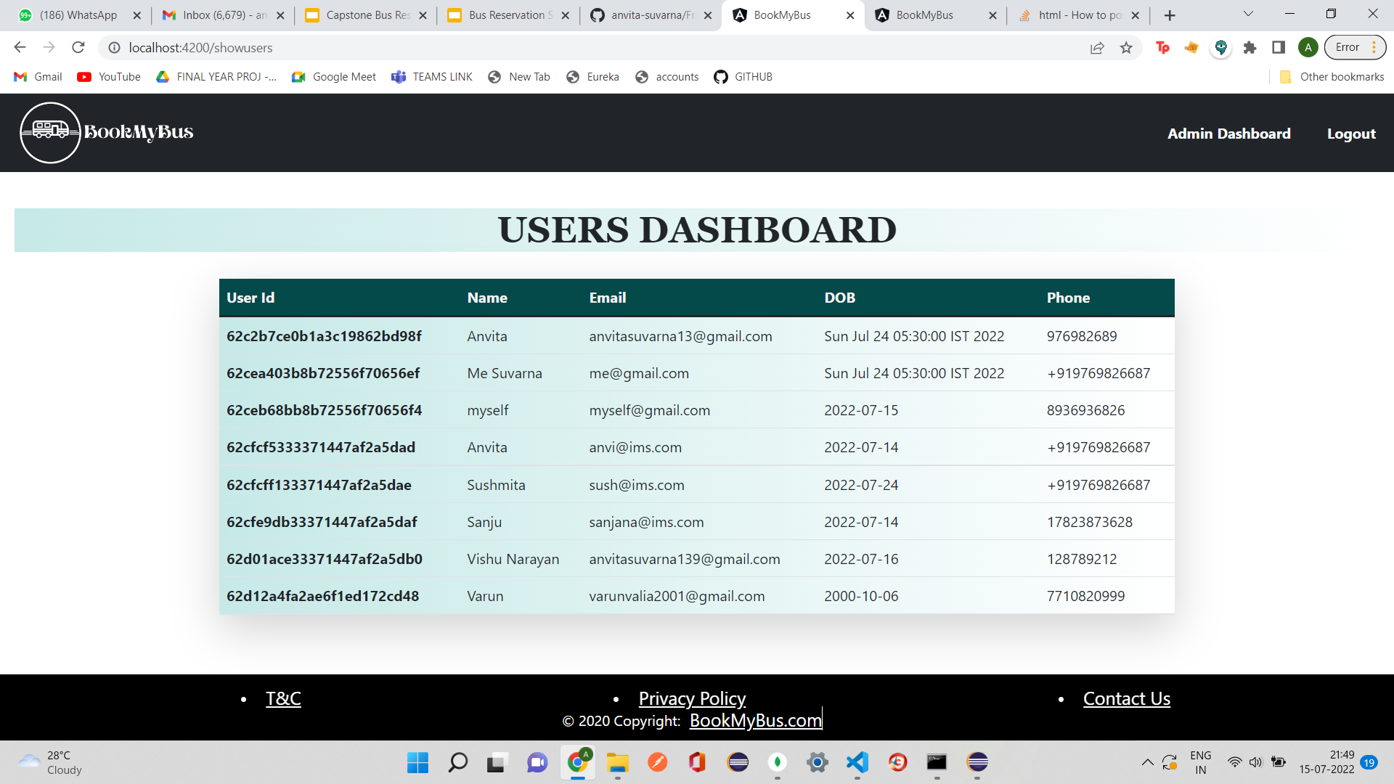
USER DASHBOARD PAGE

Slide 38
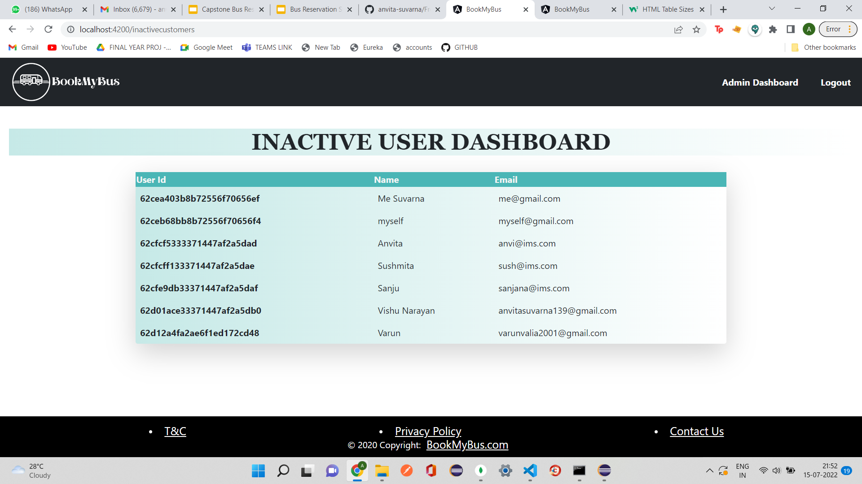
INACTIVE USER DASHBOARD PAGE

Slide 39
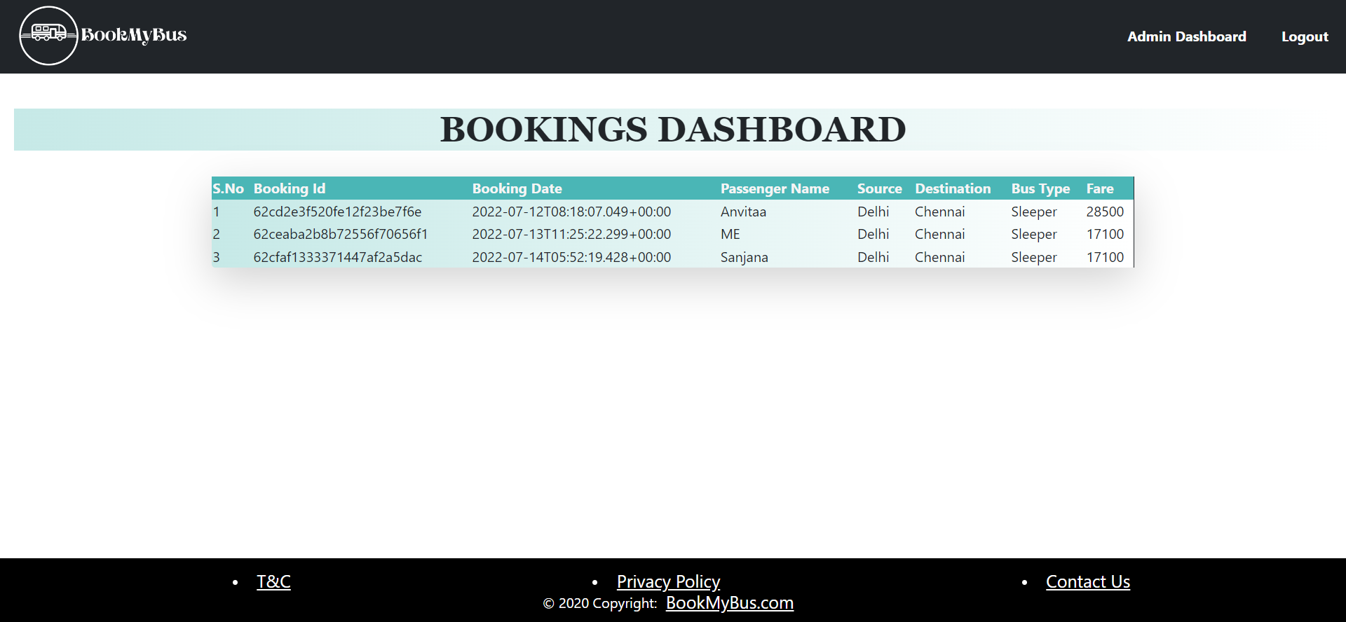
BOOKING DASHBOARD PAGE

Slide 40
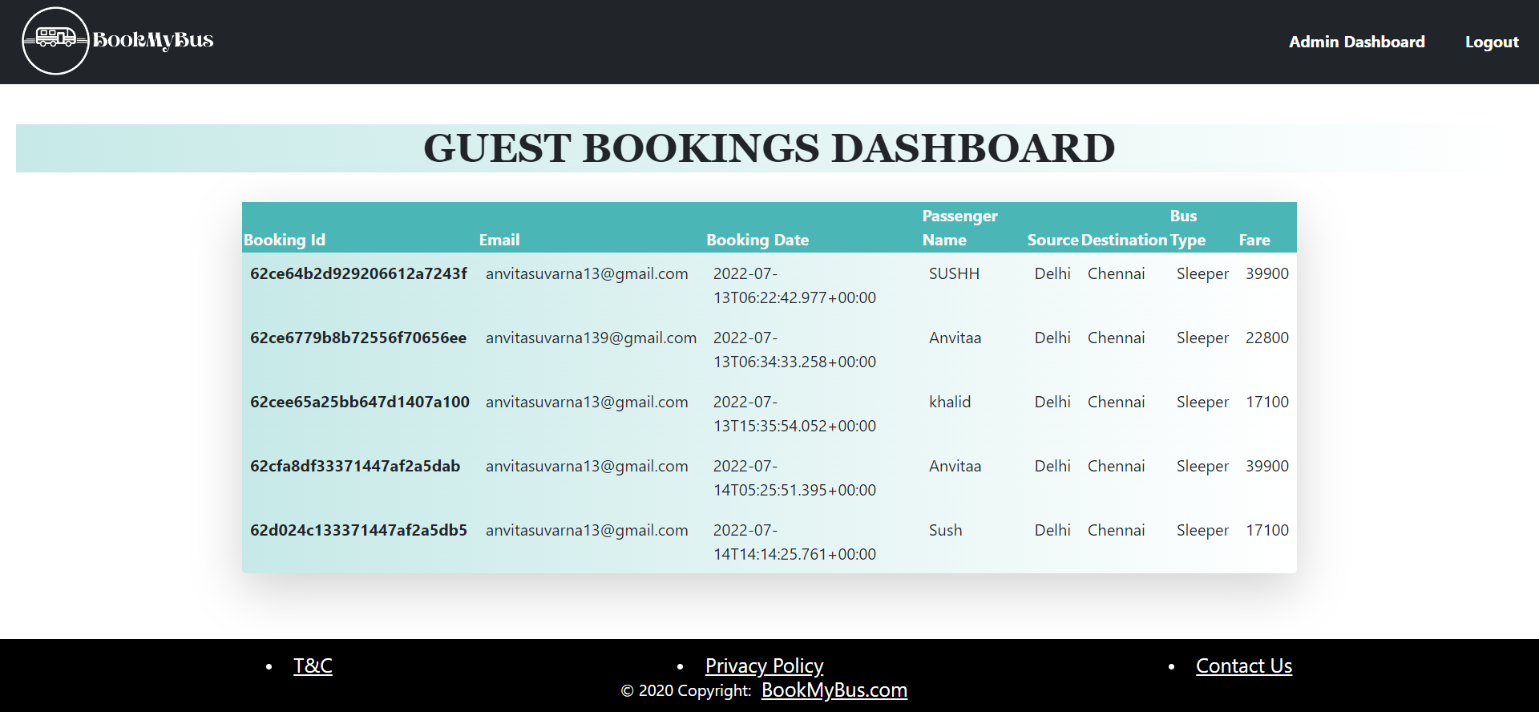
GUEST BOOKINGS DASHBOARD PAGE

Slide 41
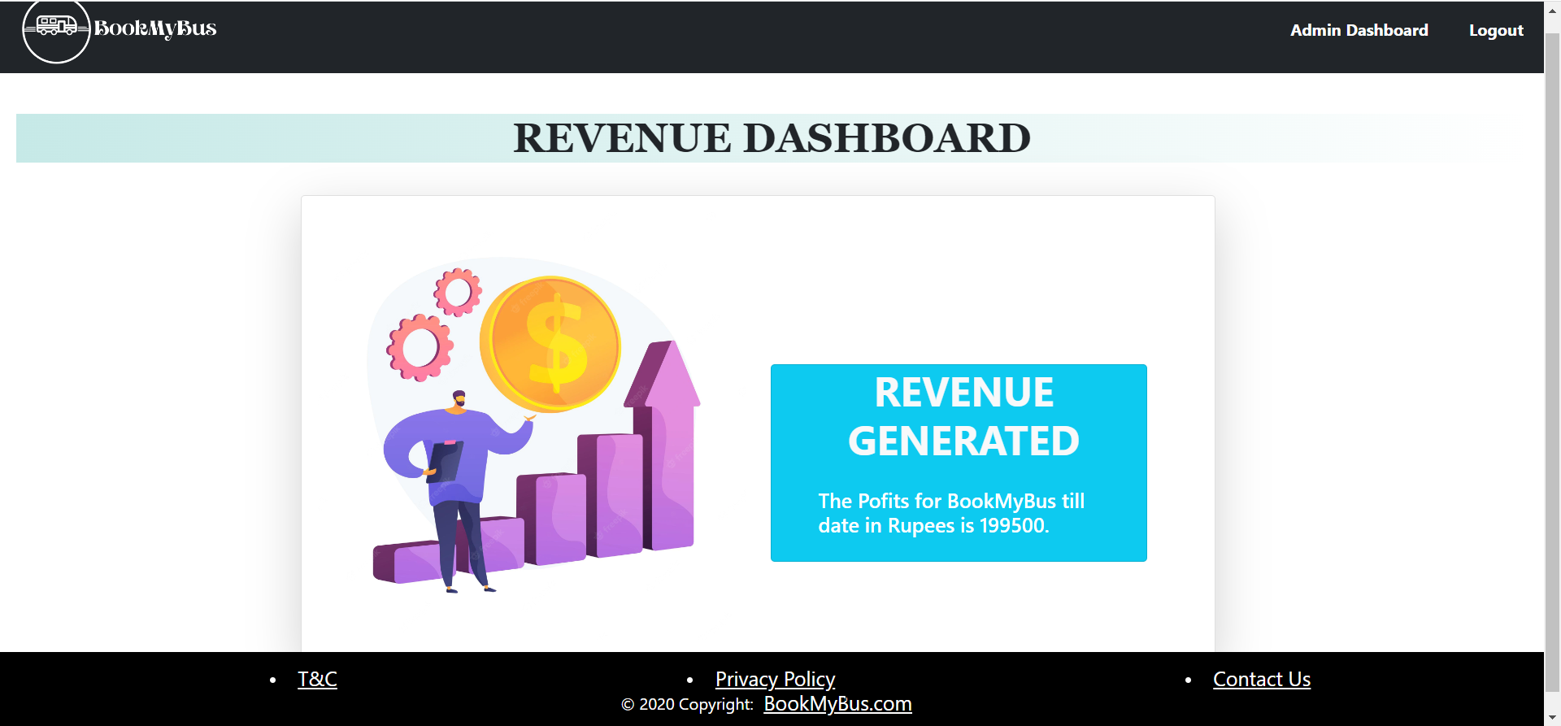
PROFITS PAGE

Slide 42
Third
section
03
SWAGGER REPORT

Slide 43
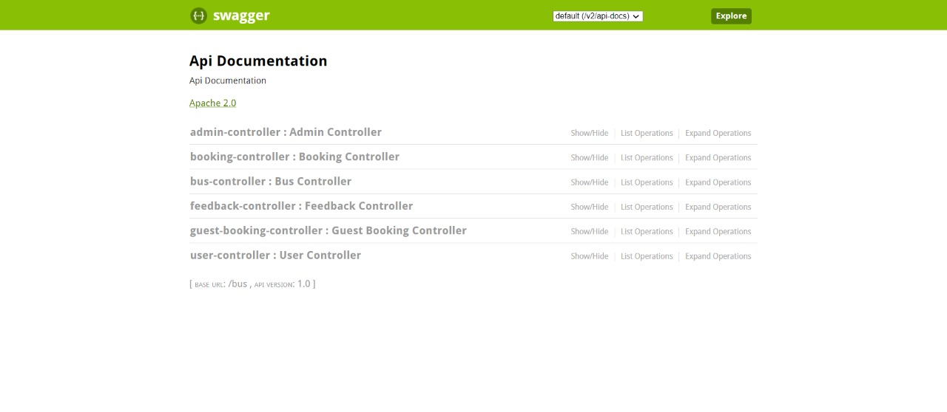
SWAGGER UI PAGE

Slide 44
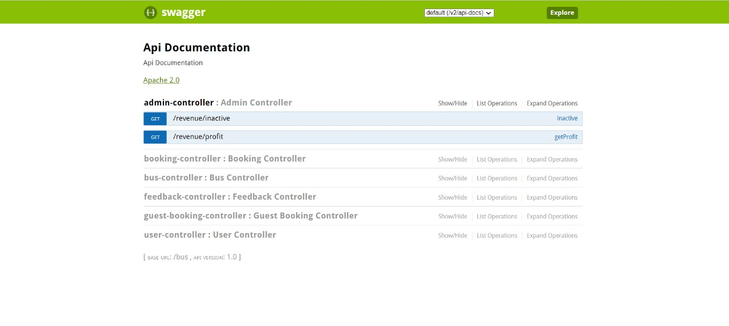
ADMIN-CONTROLLER

Slide 45
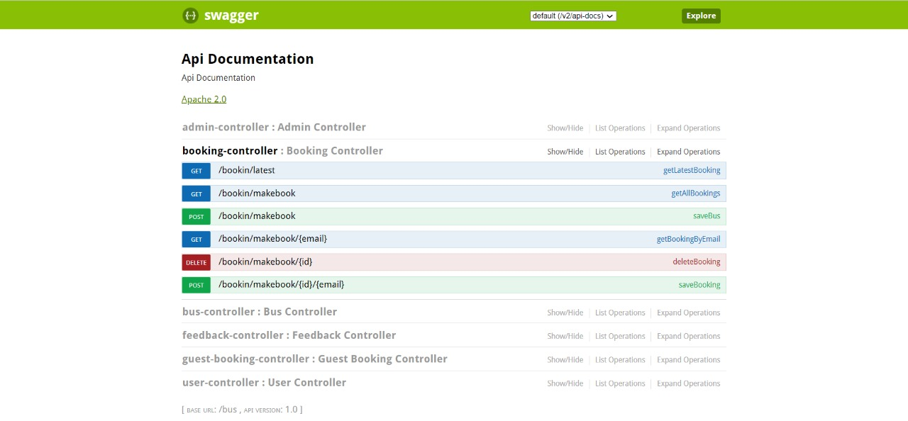
BOOKING-CONTROLLER

Slide 46
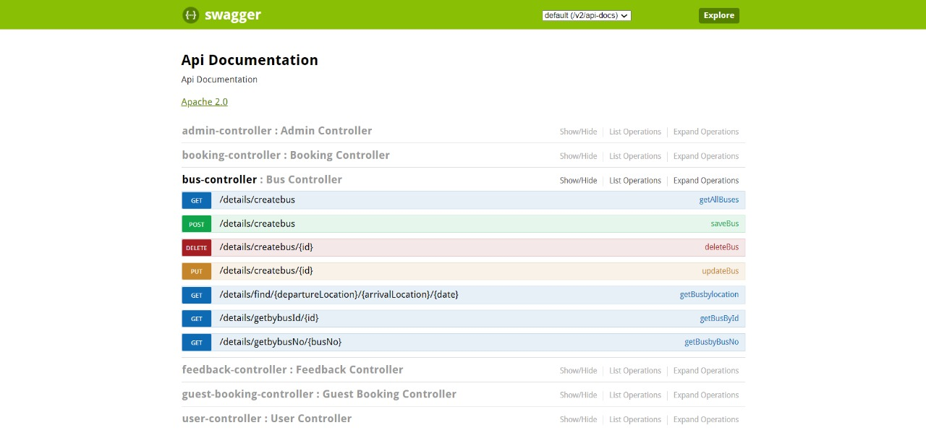
BUS-CONTROLLER

Slide 47
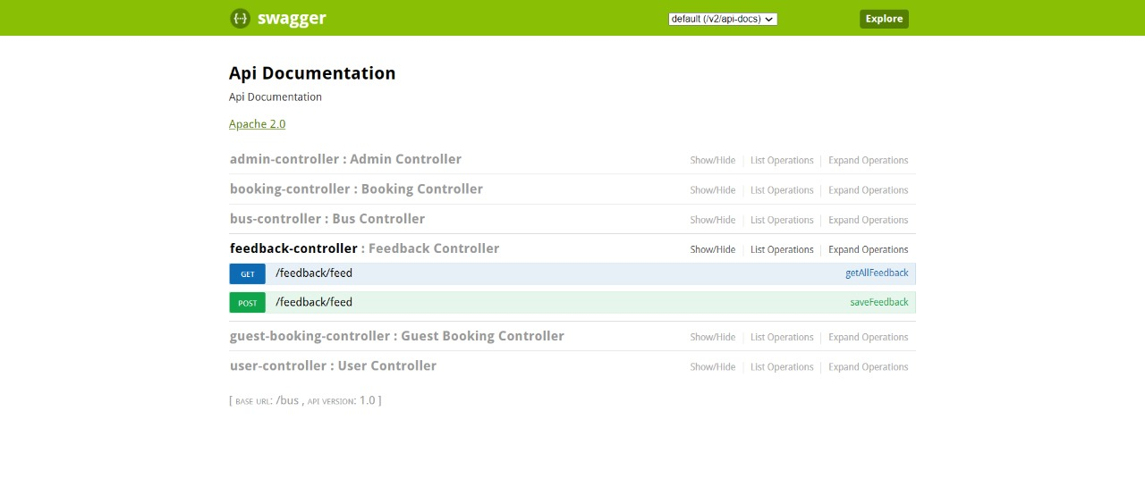
FEEDBACK-CONTROLLER

Slide 48
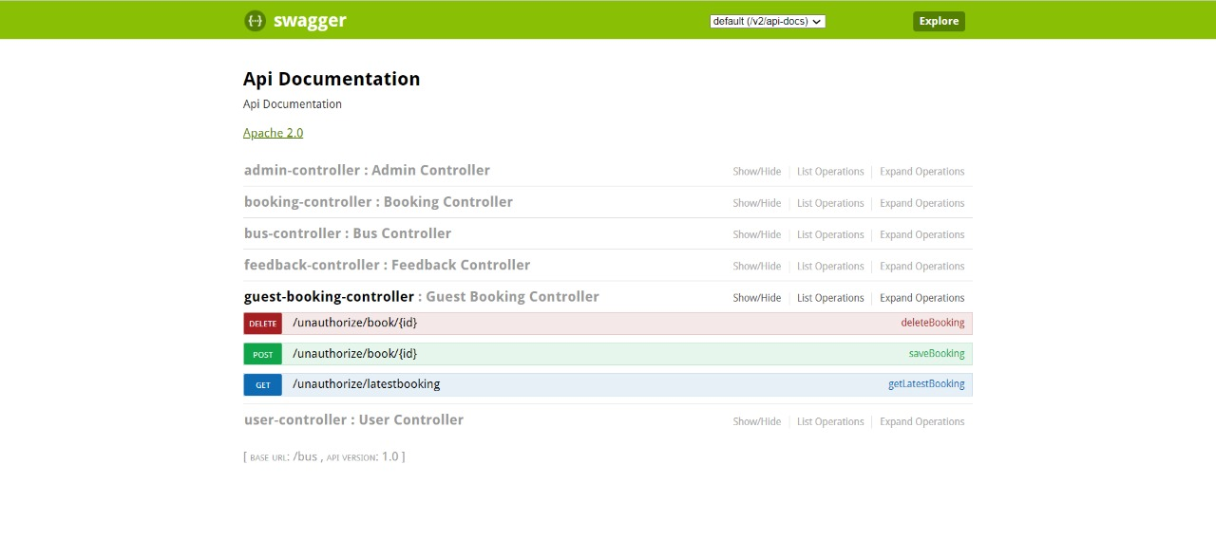
GUESTBOOKING-CONTROLLER

Slide 49
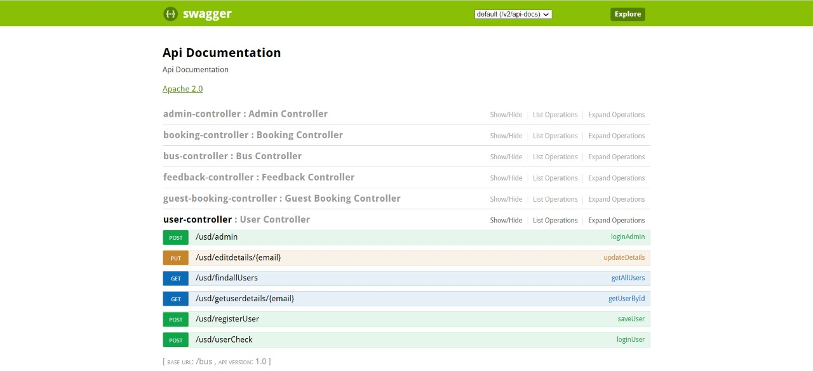
USER-CONTROLLER

Slide 50
Fourth
section
04
JUNIT TESTING REPORT

Slide 51
Junit Testing Report

Slide 52
FUTURE SCOPE
This project can be upgraded by adding more options such as ticket editing and more admin operations.
Exclusive offers, cashback, free rides and more.
Application can be upgraded by improving performance as per user feedback.

Slide 53
CONCLUSION
BookMyBus is designed to meet the requirements of an Online Bus Reservation System. We have implemented this website using Spring Boot for backend and Angular for front-end. We have designed the project to provide the user with an easy way to search, book tickets and perform other actions.

Slide 54

THANK YOU

